Slide 1
Lecture 14 – Principle Component Analysis
Hamed Hasheminia

Slide 2
Agenda
Introduction of PCA method
Computation of PCA
Geometry of PCA
Proportion of Variance explained

Slide 3
Principle Component Analysis
PCA is an unsupervised learning technique.
PCA produces a low-dimensional representation of the variables that have maximal variance, and are mutually uncorrelated
Apart from producing derived variables for use in supervised learning problems, PCA also serves as a tool for data visualization.

Slide 4




Principle Component Analysis: details
The first principal component of a set of features X₁,…,X_{p} is the normalized linear combination of the features:
That has the largest variance. By normalized, we mean that
We refer to elements as the loadings of the first principal component; together, the loadings make up the principal component loading vector,

Slide 5
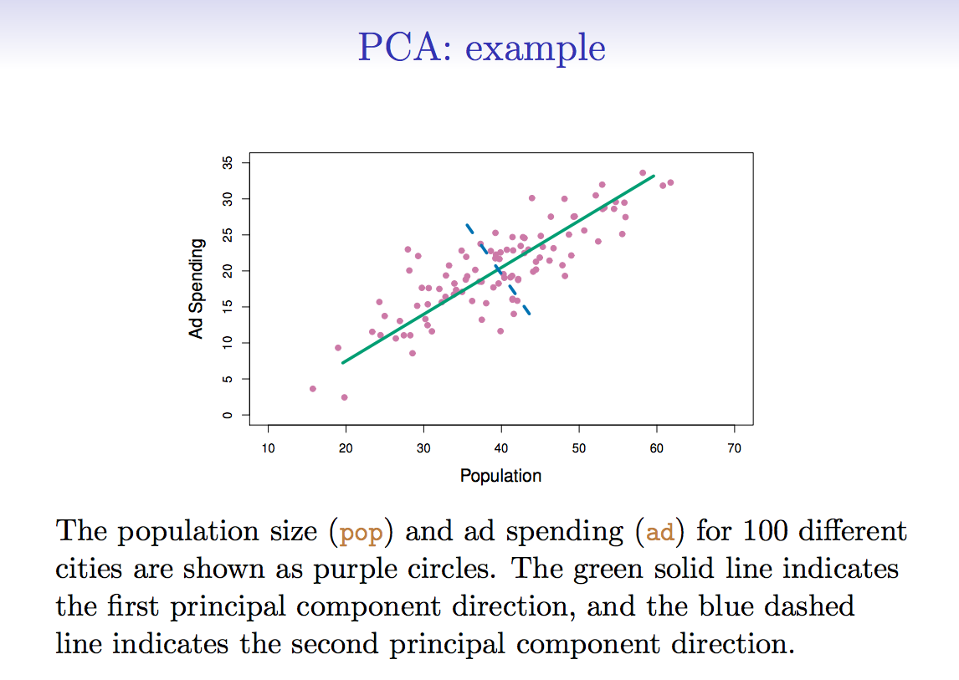
PCA: Example

Slide 6




Computation of Principle Components
Suppose we have a n x p data set X. Since we are only interested in variance, we assume that each of the variables in X has been centered to have mean zero (this is, the column means of X are zero).
We then look for the linear combination of the sample feature values of the form
For i = 1,…,n that has the largest sample variance, subject to the constraint that
Since each of the x_{ij} has mean zero, then so does z_{i1} (for any values of ). Hence the sample variance of the z_{i1} can be written as

Slide 7
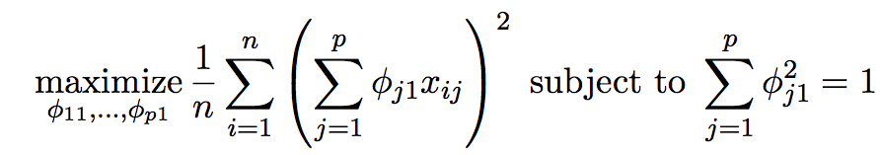
Computation: continued
Plugging in (1) the first principle component loading vector solves the optimization problem:
This problem can be solved via a singular-value decomposition of the matrix X, a standard technique in linear algebra.
We refer to Z₁ as the first principal component, with realized values z₁₁, … ,z_{n1}

Slide 8





Geometry of PCA
The loading vector with elements
Defines a direction in feature space along which the data vary the most.
If we project n data points x₁,…,x_{n} onto this direction, the projected values are the principal component scores z₁₁, … ,z_{n1}
The second principal component is the linear combination of
X₁,…,X_{p} that has maximal variance among all linear combinations that are uncorrelated with Z₁.
The second principal component scores
take the form
Where is the second principal component loading vector, with elements

Slide 9
Further principal components: continued
It turns out that constraining Z₂ to be uncorrelated with Z₁ is equivalent to constraining the direction to be orthogonal to the direction . And so on.
There are at most min(n-1,p) principal components.

Slide 10
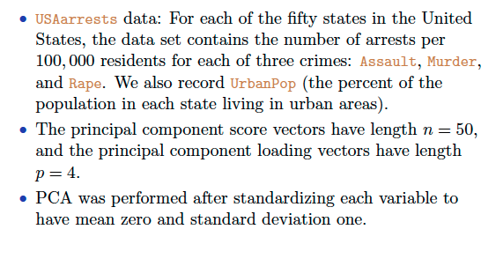
Illustration

Slide 11
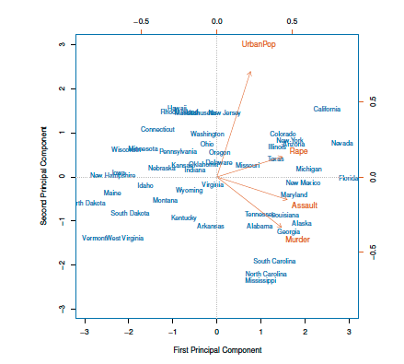

Slide 12
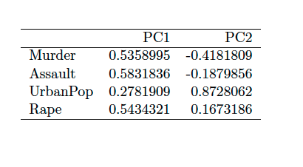
PCA - Loadings

Slide 13
PCA find the hyper-plane closest to the observations
The first principal component loading vector has a very special property: it defines the line in p-dimensional space that is closest to the n observations (using average squared Euclidian distance as a measure of closeness)
The notion of principal components as the dimensions that are closest to the n observations extends beyond just the first component.
For instance, the first two principal components of a data set space the plane that is closest to the n observations, in terms of average squared Euclidean distance.
Isn’t it the same as regression lines?
No! Can you tell me why?

Slide 14
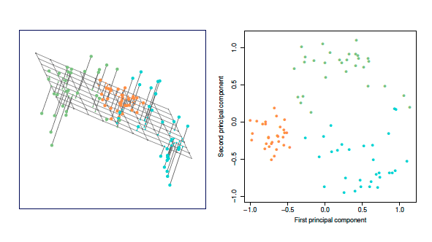
Another interpretation of Principal Components

Slide 15
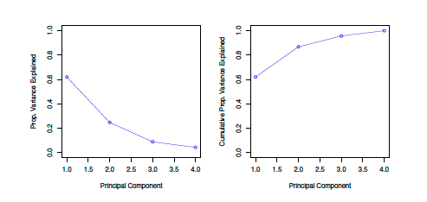
Proportion Variance Explained
To understand the strength of each component, we are interested in knowing the proportion of variance explained (PVE) by each one.

Slide 16
How many principal components should we use?
If we use principal components as a summary of our data, how many components are sufficient?
No simple answer to this question, as cross-validation is not available for this purpose.
Why not?
When could we use cross-validation to select the number of components?
The “scree plot” on the previous slide can be used as a guide: we look for an “elbow”.

Slide 17
Summary
We learned how PCAs are being computed
We learned about graphical representations of PCAs.
We conceptually explored Geometrical properties of Principal Components.
Proportion of Variance explained.

